Slide 1
WE ARE
PENN STATE LAW!
Presented by Jing Hu
Director of Graduate and International Programs, Penn State Law
Email: jxh574@psu.edu
March, 2019

Slide 2
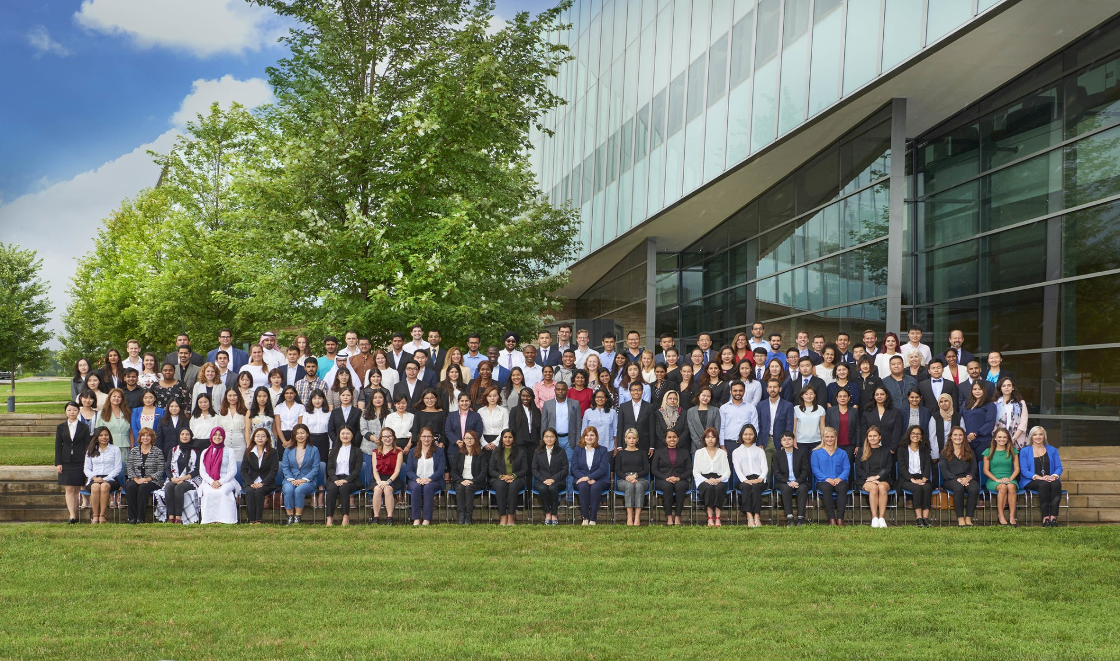
Class of 2018-2019 (34 countries!)
Notes:
The graduating class of 2019 comprises 119 LLM students and 10 exchange students—34 countries! The most diverse LLM class of its size anywhere in the world.

Slide 3
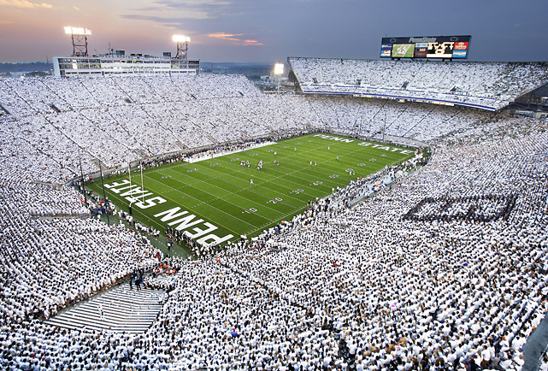
109,000 Penn Staters in World’s 4th largest stadium –September 9, 2017
Notes:
86 LL.M. students, 6 exchange students; 28 countries

Slide 4
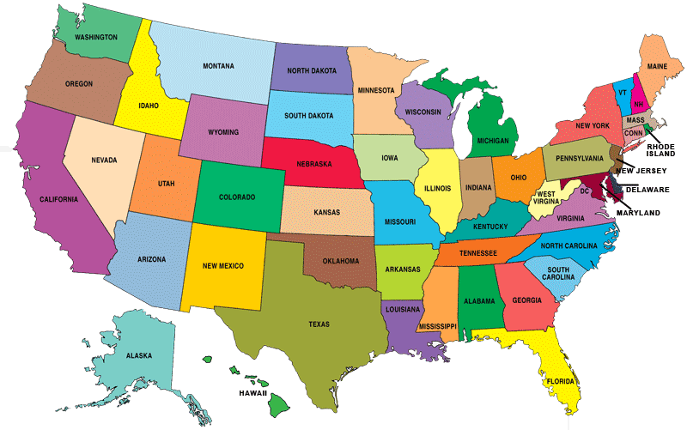
Notes:
Penn State Law (Pennsylvania State University’s law school) is located in the mid-Atlantic region (Northeast) of the USA.

Slide 5

Notes:
Penn State University, founded in 1855, is ranked among the top 60 universities in the world. Located between Pittsburgh and Philadelphia, Pennsylvania

Slide 6
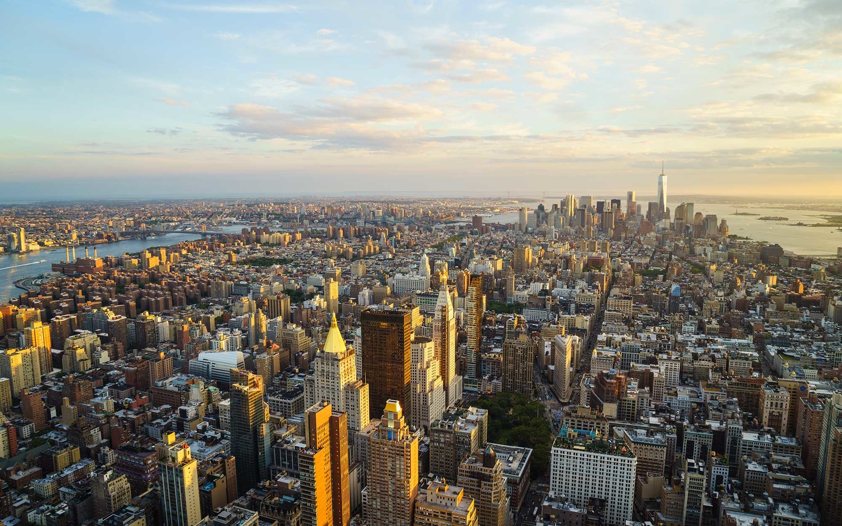
Notes:
Only 4 hours away by Megabus from midtown Manhanttan

Slide 7

Notes:
4 hours by bus or car from Philadelphia (also, University Park Airport [SCE] has direct flight from Philadelphia)

Slide 8

Notes:
3.5 hour drive from Washington DC (also, direct flights from Dulles International Airport [IAD] to University Park Airport [SCE])

Slide 9

Notes:
Penn State Law’s location! Consistent ranked among the top 10 places to live in the United States; annual university student surveys consistently rank PSU as among the top 5 campuses in the USA. Helps explain why this place is called “Happy Valley”!

Slide 10
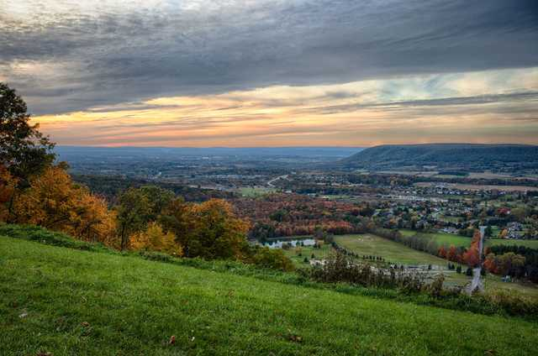
Notes:
This is a view from the nearby mountains—only 15 minutes away from campus; hiking trails everywhere (you could even hike from West Virginia through Pennsylvania to New York State on an uninterrupted trail)

Slide 11


Slide 12

Notes:
Dean Steve Barnes on his stand-up paddleboard on nearby lake, 15 minutes from campus

Slide 13
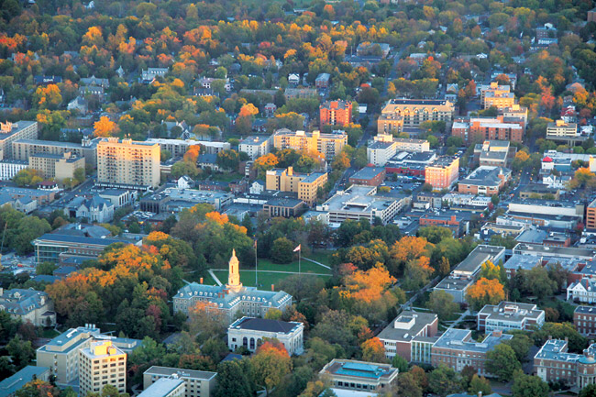
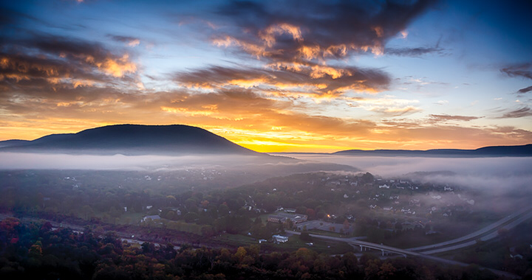
Penn State University
Notes:
Penn State University campus—bird’s eye view; founded in 1855

Slide 14
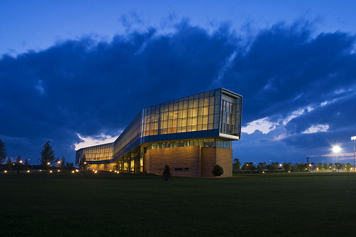
Notes:
The Katz Building. Each student has 24-hour access

Slide 15
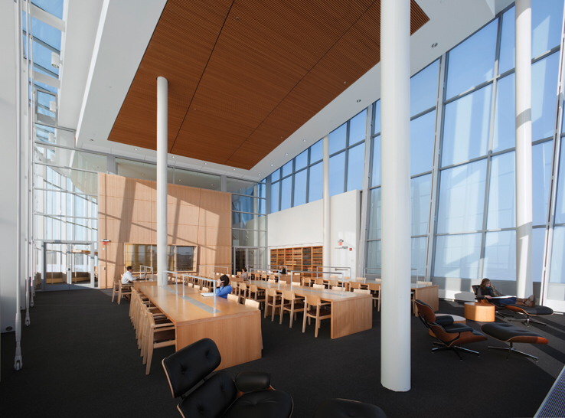
Notes:
The Katz reading room

Slide 16

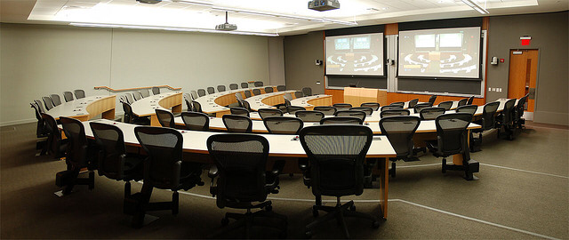

Slide 17
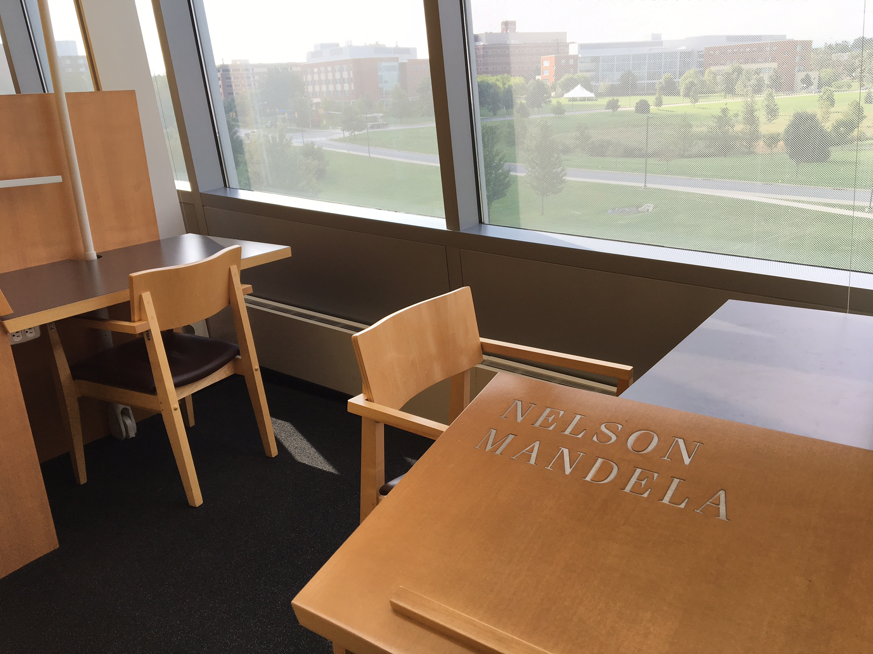
Notes:
http://www.collegian.psu.edu/news/campus/article_64928c2c-bc99-11e4-9d11-47cbba6c9a34.html

Slide 18
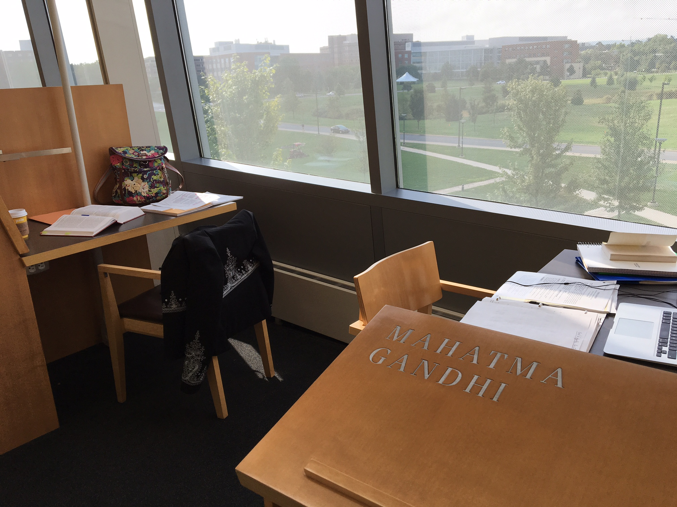

Slide 19
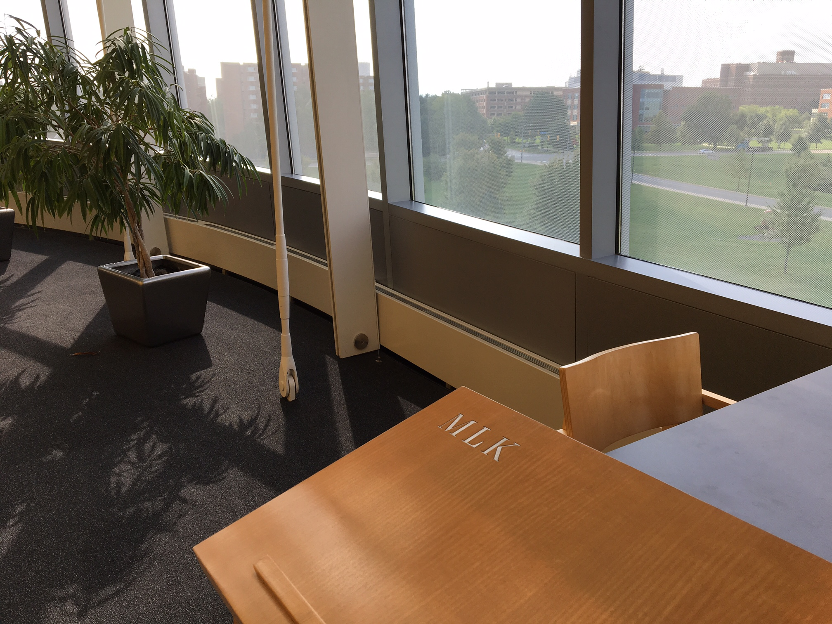
Notes:
MLK Jr. spoke at PSU on 1/21/1965. Here is the transcript: https://www.libraries.psu.edu/psul/speccolls/mlk_psu.html

Slide 20
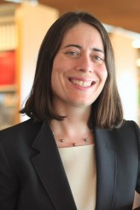
Dean Hari M. Osofsky, Ph.D.
Professor of Law
Professor of Geography
Professor of International Affairs
Environmental Law
Energy Policy
Technology and Law

Slide 21
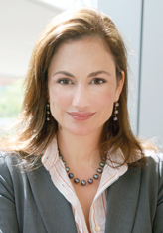
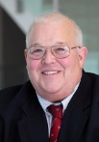
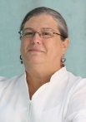
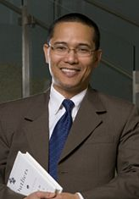
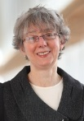
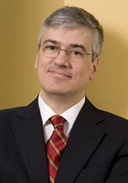
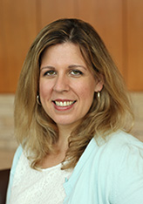
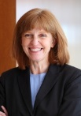
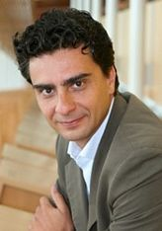
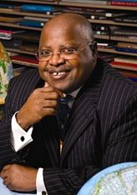
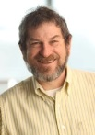
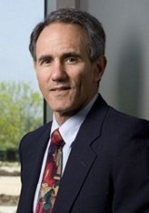
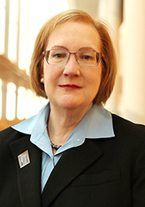
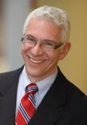
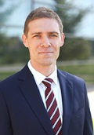
Notes:
Selected faculty among the 40+ full-time faculty members
https://pennstatelaw.psu.edu/faculty/rogers
https://pennstatelaw.psu.edu/faculty/carbonneau
https://pennstatelaw.psu.edu/faculty/brunner
https://pennstatelaw.psu.edu/faculty/purvis
https://pennstatelaw.psu.edu/faculty/romero
https://pennstatelaw.psu.edu/faculty/ventoruzzo
https://pennstatelaw.psu.edu/faculty/maluwa
https://pennstatelaw.psu.edu/faculty/tridimas
https://pennstatelaw.psu.edu/faculty/ross
https://pennstatelaw.psu.edu/faculty/backer
https://pennstatelaw.psu.edu/faculty/kinports
https://pennstatelaw.psu.edu/faculty/kaye
https://pennstatelaw.psu.edu/faculty/farmer
https://pennstatelaw.psu.edu/faculty/reilly
https://pennstatelaw.psu.edu/faculty/mathews

Slide 22

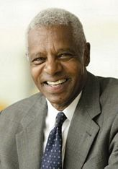
Notes:
In addition to being one of the USA’s foremost legal authorities on M&A Law, Professor Thompson served for 15 months as advisor to President Nelson Mandela.
https://pennstatelaw.psu.edu/faculty/thompson-jr
http://libguides.law.virginia.edu/faculty/thompson; Tax policy advisor (on behalf of the U.S. Treasury Department) to the Ministry of Finance, Pretoria, South Africa (15 months); http://www.thehistorymakers.com/biography/samuel-c-thompson-jr

Slide 23
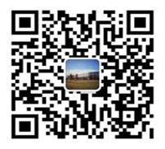
LL.M. Program Application timelines and scholarships
Scholarships, ranging from $ 35,000 to 40,000, based upon:
  Academic performance
  Professional, volunteer experience
  Financial need
  Other (“intangibles”), e.g., diversity, other experience
For more information, please contact Penn State Law Admission Office (email: llmadmit@pennstatelaw.psu.edu )
Or add WeChat:
ID: PennStateLawLLM
Notes:
Const’l amendments, 2 ways:
2/3 of both chambers + ¾ of all state legislatures … or
Const’l convention of 2/3 of all state legislatures, then approved by ¾ of all state legislatures
Veto successful less than 10%

Slide 24
Penn State Law’s application requirements
On-line (or LSAC) application – no fee
Transcripts
CV
Personal Statement
Two (2) letters of recommendation
TOEFL and IELTS English proficiency exams (82 and 6.5 respectively—but interviews)

Slide 25
You’ve been admitted (congratulations!)
Now what?
Within ten (10) days you will receive an admittance letter (email, followed by first-class mail) with enclosures on next steps
You will complete the acceptance form (exchange and study abroad students) and remit; LL.M. students will submit a $500 deposit (within 30 days) to reserve the seat
Within 5-7 business days upon receipt, Penn State Law’s Global Programs will send you visa documents for you to complete. Remit to Global Programs
Within 3-6 weeks, you will receive your I-20 form (invitation for U.S. Embassy interview)
April (date to be determined) – Virtual Open House; logistical details
Faculty advisor; Facebook, “Let’s Get Acquainted”
Housing (information provided)
See you in Happy Valley (Penn State Law)!

Slide 26
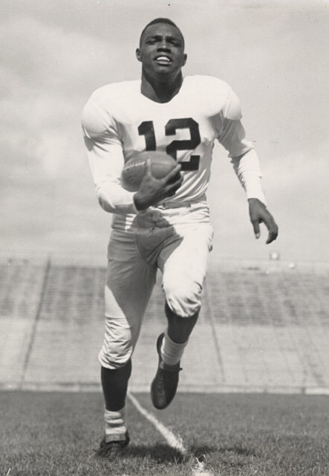
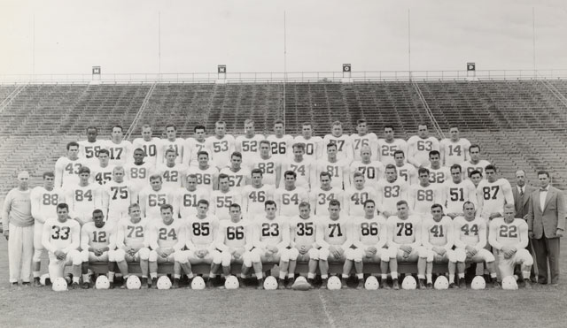

1948 Cotton Bowl, Texas
Wally Triplett
Steve Suhey
"WE ARE PENN STATE"
Notes:
The origins of “WE ARE.” Penn State’s football team was invited to play in the national championship game against at team in Texas (the “World Cup” of American sports). A moral choice: would PSU follow Texas’s rule that PSU’s African American player could not take the pitch? No. The team voted unanimously that either all would play or none would play (forfeit the game). The Texas side asked “why”? Answer: Because “We ARE Penn State). http://www.centredaily.com/sports/college/penn-state-university/article42800379.html

Slide 27
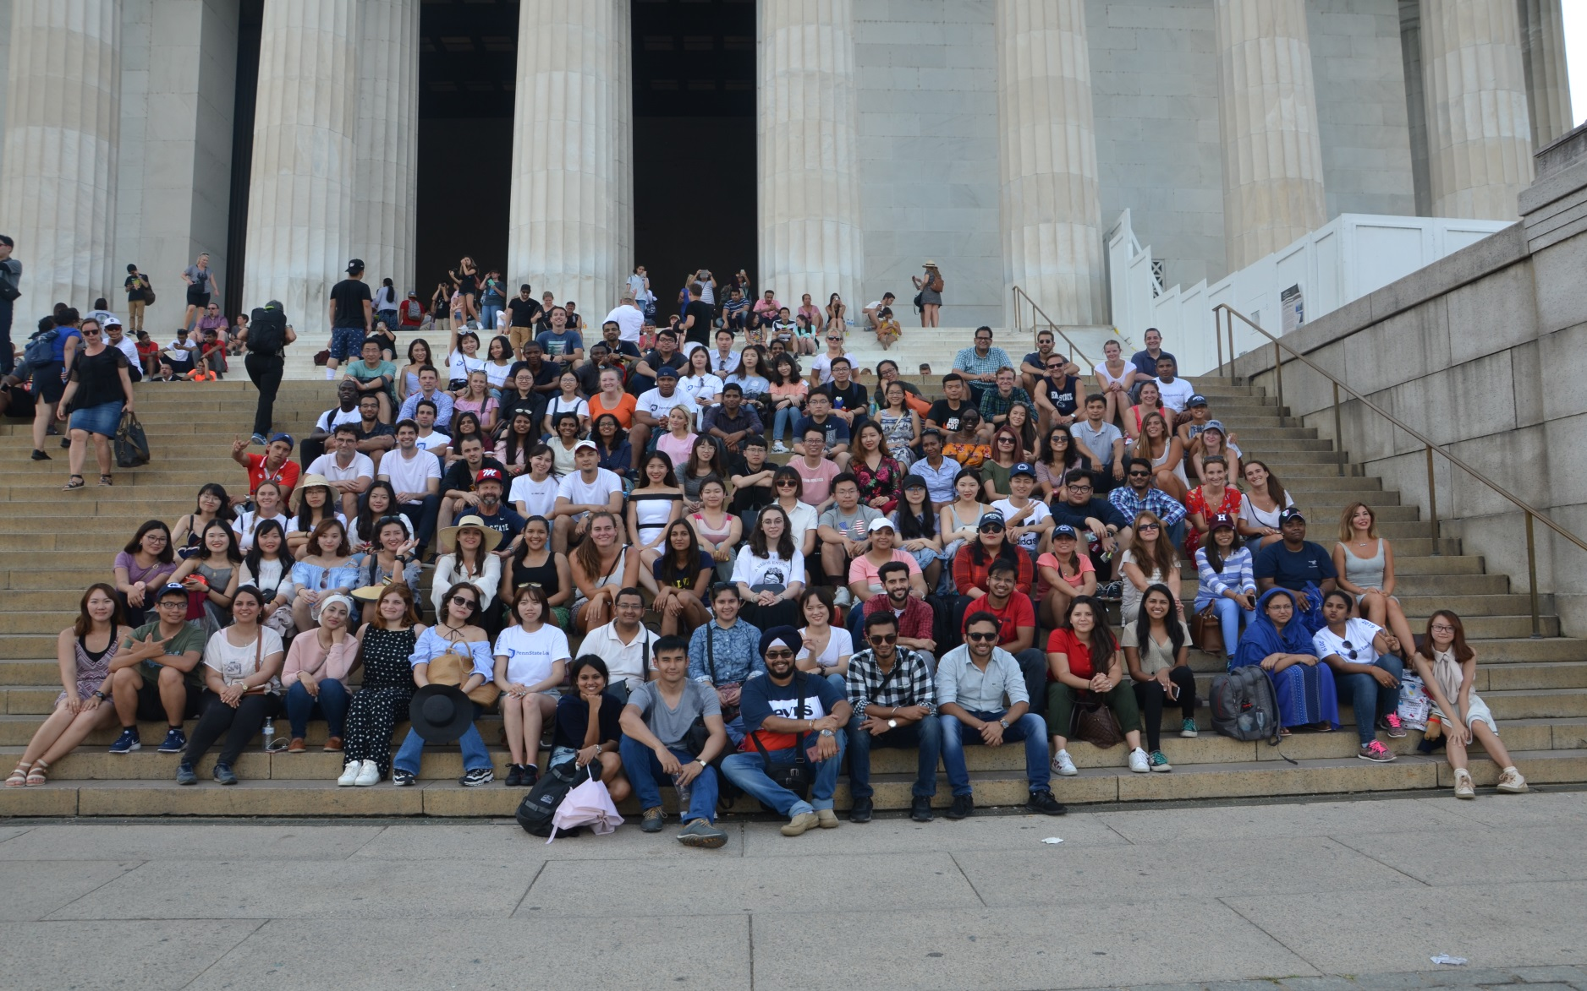
WE ARE and WE HAVE a dream!

Slide 28
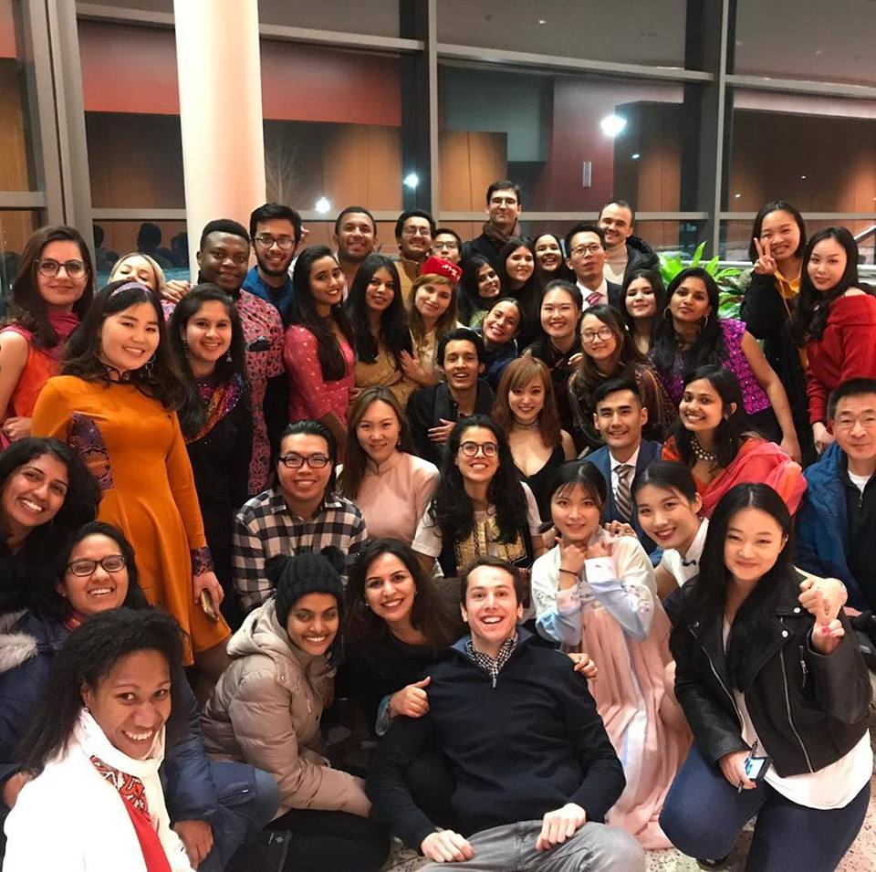
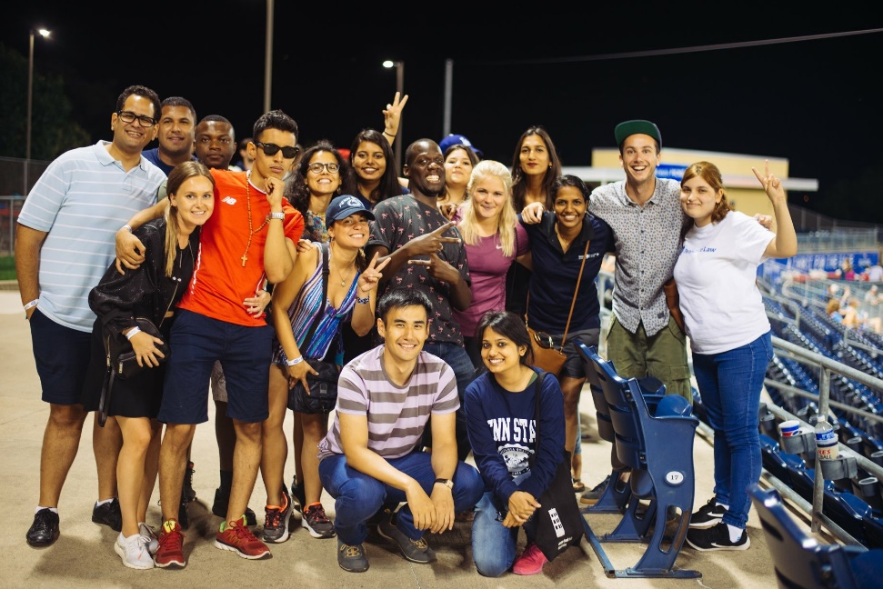
Student life

Slide 29
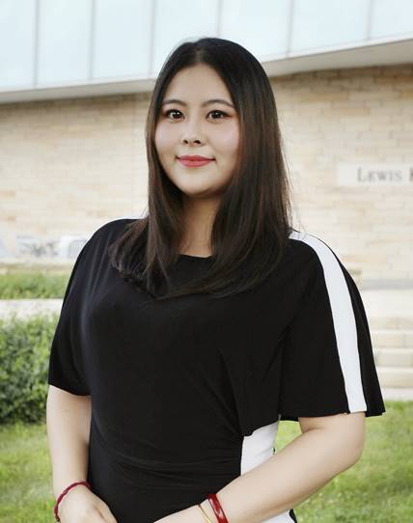
Contact information
Yuan Zhao Si Meng, Director of China Programs
  Email: zzy62@psu.edu
  WeChat ID: PennStateLawLLM

Slide 30
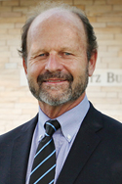
Contact information
Stephen G. Barnes (“Steve”), Assistant Dean, Graduate and International Programs
Email: sgb14@psu.edu

Slide 31
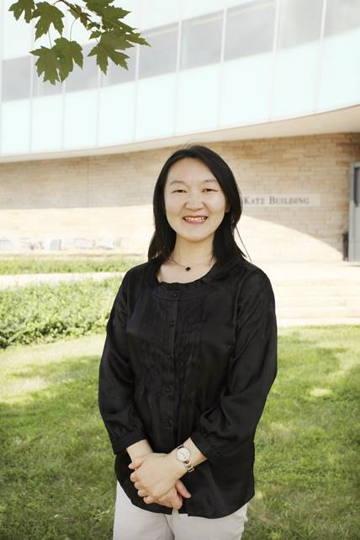
My contact information
Hu Jing, Director of Graduate and International Programs
Email: jxh574@psu.edu

Slide 32
Tack så mycket!
My contact information
Stephen G. Barnes (“Steve”), Assistant Dean, Graduate and International Programs
Email: sgb14@psu.edu
Notes:
For more information, please contact Steve Barnes

Slide 33


Social media
Weibo ID: 美国宾州州立大学法学院PSU_LAW
Youku ID:美国宾州州立大学法学院
Link： http://i.youku.com/pennstatelaw?spm=a2hzp.8244740.0.0

